Slide 1
Credit Rating Prediction using Machine Learning
A case study on modeling corporate creditworthiness from financial data
Presented By:
Josmin Theresa Babu

Slide 2
Agenda
Objective
Dataset Overview
Data Cleaning Strategy (TOMI)
Exploratory Data Analysis (EDA)
Modelling Approach & Challenges
Model Evaluation
Key Findings
Next Steps / Q&A

Slide 3
Project Overview & Objective
Business Context
Credit ratings help investors and institutions assess the creditworthiness of companies. Ratings like AAA, BB, or C reflect the company’s financial health and default risk.
Objective
To build a machine learning model that can accurately predict corporate credit ratings using financial indicators, making the credit assessment process faster, scalable, and more data-driven.
Why it matters:
Credit ratings influence investment decisions, borrowing costs, and risk perception
Traditional methods rely on manual assessments by rating agencies.
Automating this process with ML can reduce time, human bias, and enhance early warning systems.

Slide 4
Data Overview
Size & Shape
Total Records : 2434
Total Features : 30
Target Variable : Rating (AAA to D)
Feature Types:
Financial ratios, that helps assess the company’s
Liquidity :which show a company’s ability to pay short-term obligations.
Profitability : measure how effectively a company generates profit.
Leverage: indicating how much debt the company carries.
Efficiency : showing how well the company uses its assets.
Cash Flow : revealing how stable the company’s actual cash generation is.
Categorical : Sectors, Rating Agency Name, Company Name

Slide 5
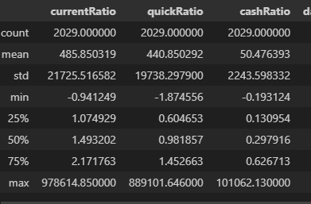
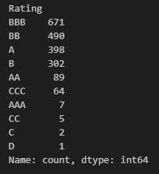
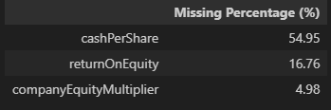
Initial Observations
Presence of missing values, duplicates and outliers
Duplicate : 405 rows
Severe imbalance observed: AAA, C, D have < 10 instances, while BBB has 671. This directly impacted model performance
Features are all numeric and scaled differently
Large variance in scales (e.g., cashRatio vs returnOnAssets)

Slide 6
Data Cleaning Strategy – TOMI + KNN Imputation
TOMI (Treatment of Outliers as Missing with Imputation) was used to handle both outliers and missing values in a unified, robust manner.
Why TOMI?
Outliers were treated as missing values instead of dropping or capping them, preserving useful patterns.
This approach avoids harsh transformations and lets the imputer fill values based on data distribution.
Imputation with KNN
KNN Imputation was used instead of median:
Median reduces variability – especially problematic for skewed financial data like CashPerShare
KNN retains natural variance by imputing values based on nearest neighbors.
Outcome
Effectively addressed outliers and missing values.
Preserved feature distributions and variance
Clean, imputed data ready for modelling

Slide 7
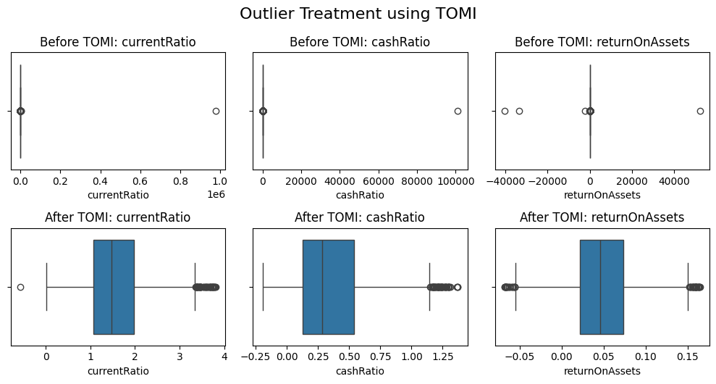
TOMI (Treatment of Outlier data as Missing using Imputation) is not an aggressive clipping method — it identifies only statistically extreme values (beyond 3 IQR or z-score thresholds) as true outliers and treats them as missing.
Then, instead of replacing these with medians or fixed bounds, we use KNN imputation to estimate values more naturally based on their nearest neighbors in the dataset.

Slide 8
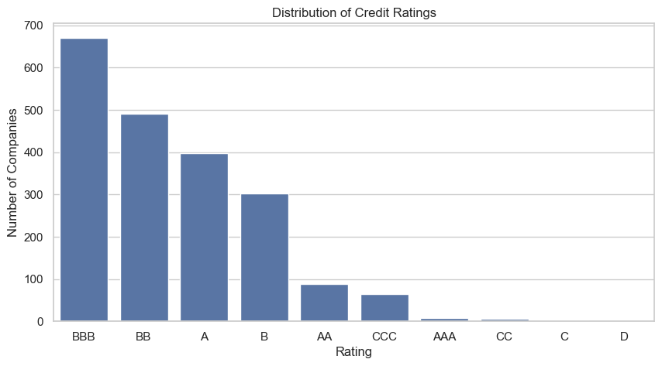
Exploratory Data Analysis (EDA)
Distribution of Credit Ratings
Severe class imbalance observed. Majority ratings are clustered around BBB and BB. Very few examples of AAA or C.

Slide 9
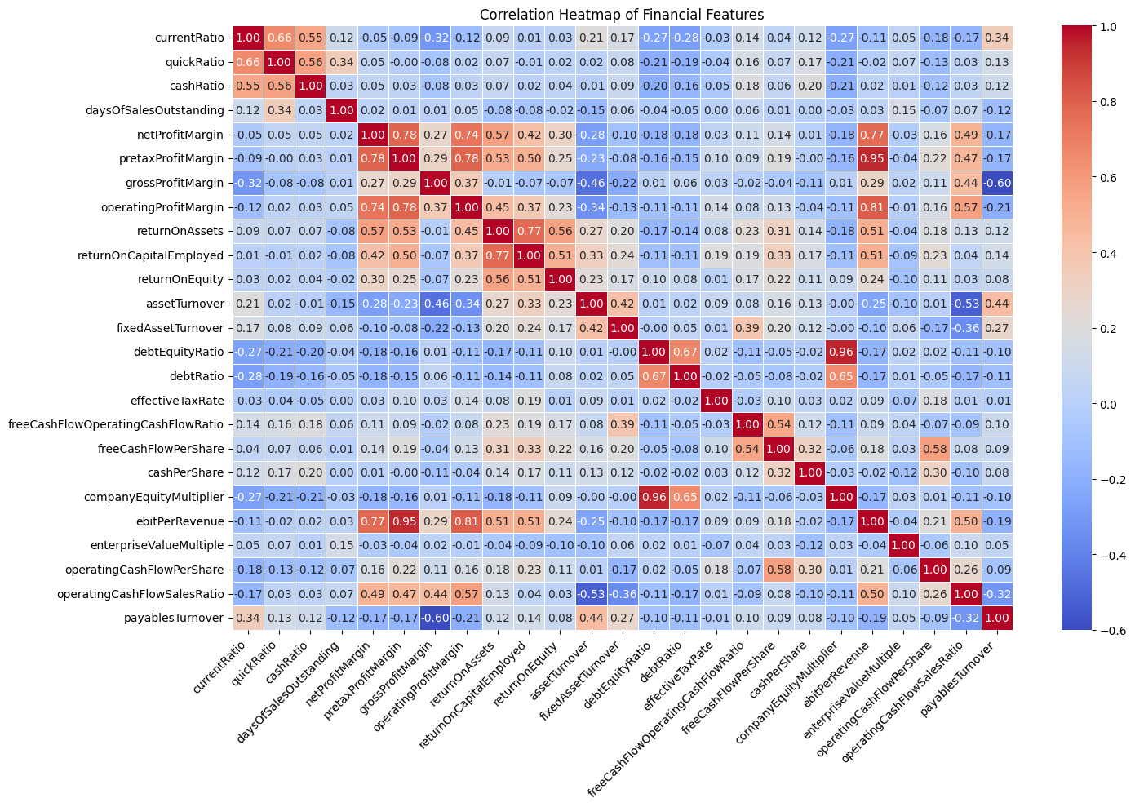
2. Correlation Between Features
Most features show moderate or low correlation with each other.
Only a few pairs have correlation values above 0.8, indicating some mild multicollinearity, but nothing alarming.

Slide 10
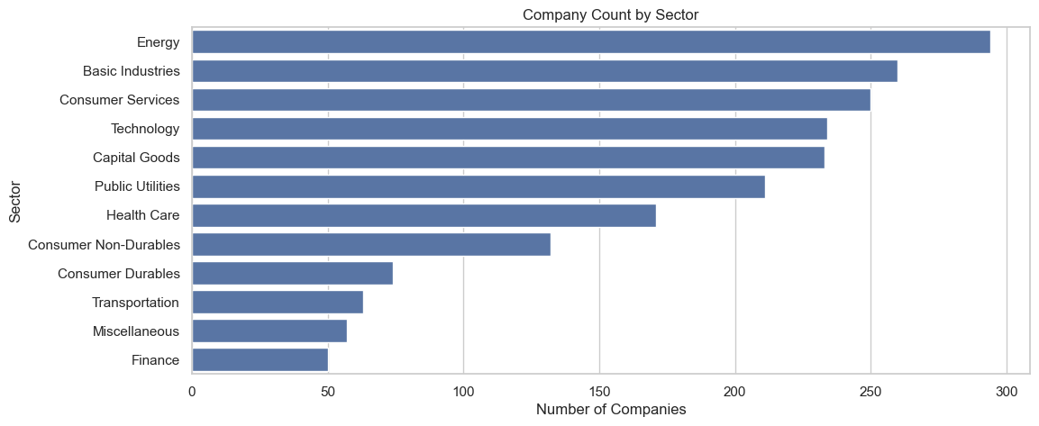
3. Sector Distribution
Highly Skewed Sector Allocation
The Energy, Basic Industries, and Consumer Services sectors dominate the dataset, each with 250+ companies.

Slide 11
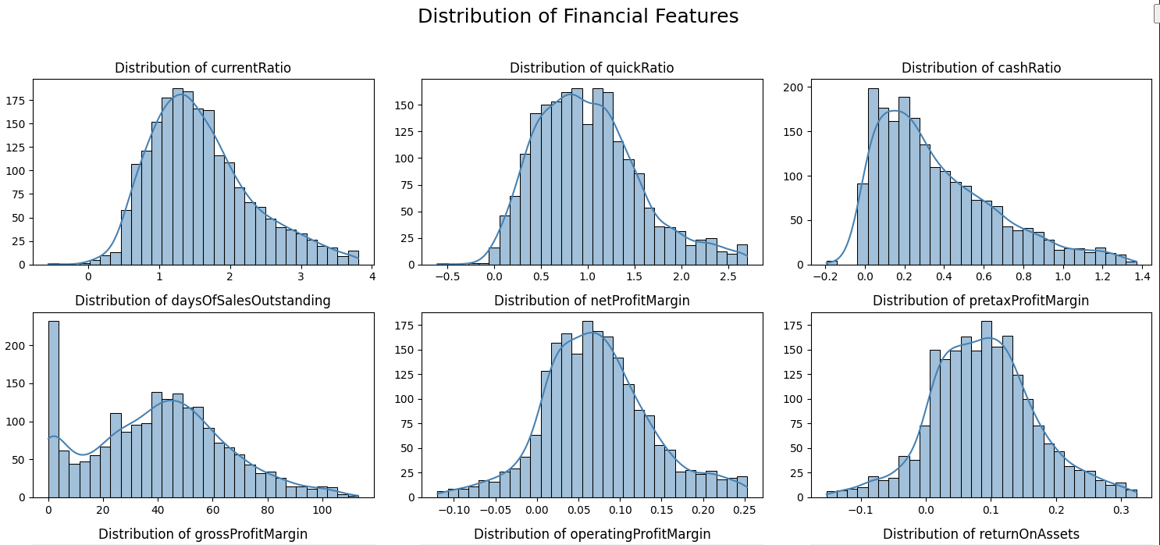
4.Feature Distribution
This plot shows the distribution of key financial ratios after data cleaning. Most features exhibit varying degrees of skewness, indicating that companies differ significantly in financial health.

Slide 12
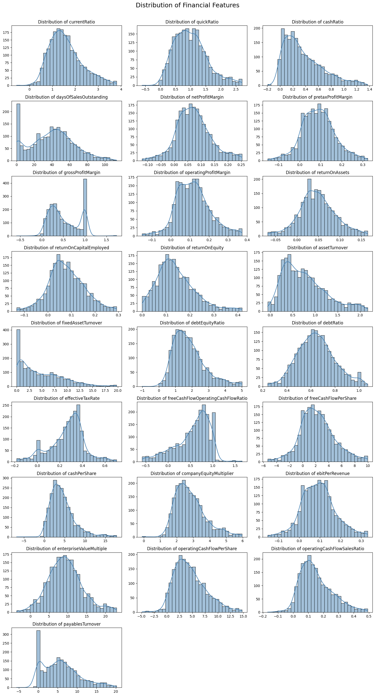

Slide 13
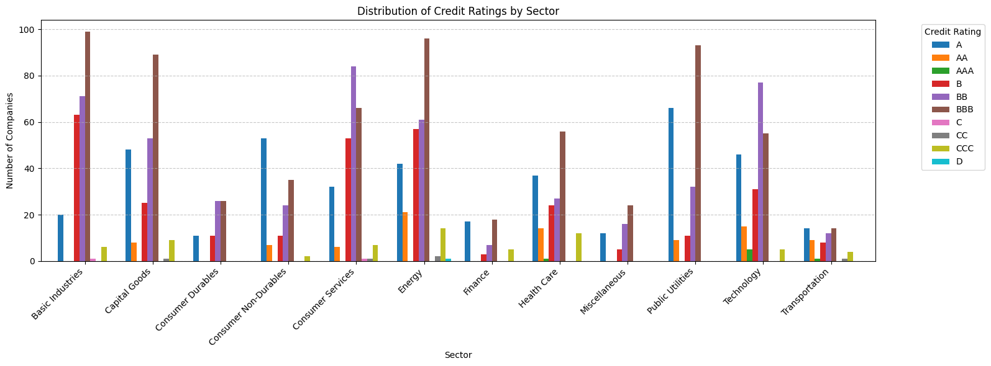
5.Sector vs Rating
Sector doesn't strongly determine rating: The distribution of ratings is fairly similar across all sectors, meaning no sector appears to inherently guarantee a higher or lower credit rating.

Slide 14
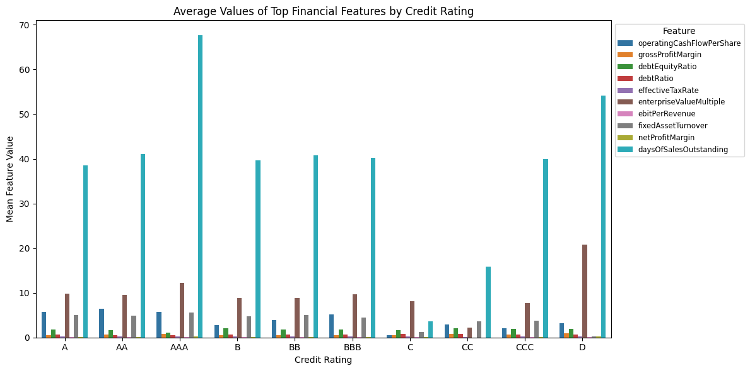
6.Features Vs Ratings
Why is days of sales outstanding(DSO) higher for AAA companies? Shouldn’t it be lower, since they’re financially strong? Could this be a data entry error?

Slide 15
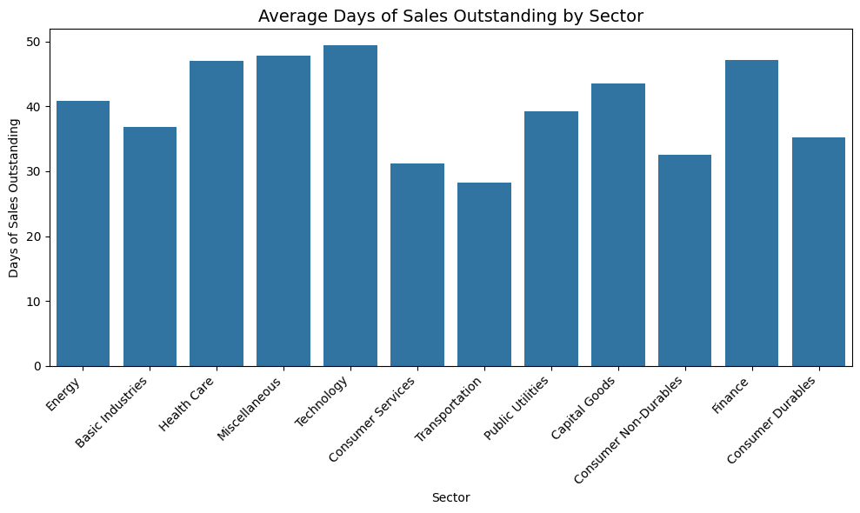
Explaining Sector, DSO, and Credit Ratings
Technology, Finance, Health Care, and Miscellaneous have relatively higher DSO, often in the range of 45–50 days.
Transportation, Consumer Non-Durables, and Basic Industries show much lower DSO, between 28–35 days.

Slide 16
EDA Summary
Credit Rating Distribution is Highly Imbalanced
Low to Moderate Feature Correlations
Sector Distribution is Skewed
Feature Distributions Are Skewed
Sector Doesn't Strongly Predict Rating Alone
The importance of context-aware feature interpretation.

Slide 17
Model Building & Challenges
Objective: Build a machine learning model to predict credit ratings based on financial features (Multi-classification problem)
Input Features: Financial ratios + encoded sector
Target : Rating (AAA to D)
Models used : Logistics Regression , Decision Tree , Random Forest , XGBoost
Evaluation Metrics : Recall, Precision
Key Modeling Challenges
Severe Class Imbalance
Multi-Class Complexity
Rare Class Overfitting
SMOTE Limitations

Slide 18
Model Building Pipeline
1.Data Preparation (handling null value, outliers)
2.Encoding
Ratings (AAA to D) mapped to numeric values (0 to 9) and grouped labelling.
Applied frequency encoding to the 'Sector' feature.
3. Feature Scaling
Used RobustScaler to handle outliers effectively.
4.Modelling Strategy
Stage 1:Exact Rating Prediction (Multi-Class)
Stage 2:Grouped Risk Classification (4 Classes)
5.Hyperameter Tuning
Performed Grid Search with 5-Fold Cross-Validation on Random Forest and XGBoost
6.Evaluation Metrics
Used Recall and Precision as primary metrics due to class imbalance
7.Feature Importance
Evaluated important features using model-based importance from Random Forest.
8.SHAP Analysis
Making the Model more explainable

Slide 19
Stage 1: Exact Rating Prediction (Multi-Class)
Objective: Predict exact credit rating (AAA to D) → Multi-class classification (9 classes).
Models Used
Baseline Models: Logistic Regression, Decision Tree
Advanced Models: Random Forest, XGBoost
Challenges
Severe class imbalance (some ratings very underrepresented).
Overfitting risk on rare classes due to SMOTE limitations.
Evaluation Metrics
Precision, Recall (especially important in imbalanced classes)
Rating | Numeric Order | Count
AAA | 9 | 7
AA | 8 | 89
A | 7 | 398
BBB | 6 | 671
BB | 5 | 490
B | 4 | 302
CCC | 3 | 64
CC | 2 | 5
C | 1 | 2
D | 0 | 1

Slide 20
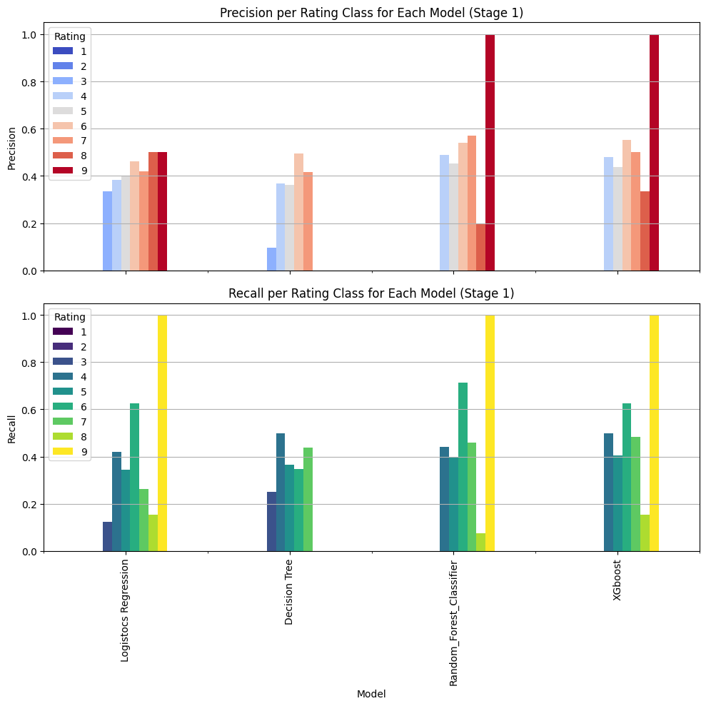
Model’s Performance – Stage 1 (Exact Rating Prediction)

Slide 21
Stage 2: Grouped Risk Classification (4 Classes)
Why Group?
SMOTE ineffective when samples < 10 in a class.
Prevents overfitting from duplicated rare records
Group Mapping Class Distribution
Modeling Steps:
Trained same 4 models on grouped data.
Then applied SMOTE to balance class 3 (Highly speculative)
Performed Hyperparameter tuning using GridSerachCV (5-fold cross- validation) for both Random Forest and XGBoost
Rating | Grouped label
AAA,AA,A | Investment Grade
BBB | Medium Grade
B,BB | Speculative
CCC,CC,C | Highly Speculative
Label | Count
Investment Grade | 792
Medium Grade | 671
Speculative | 494
Highly Speculative | 71

Slide 22
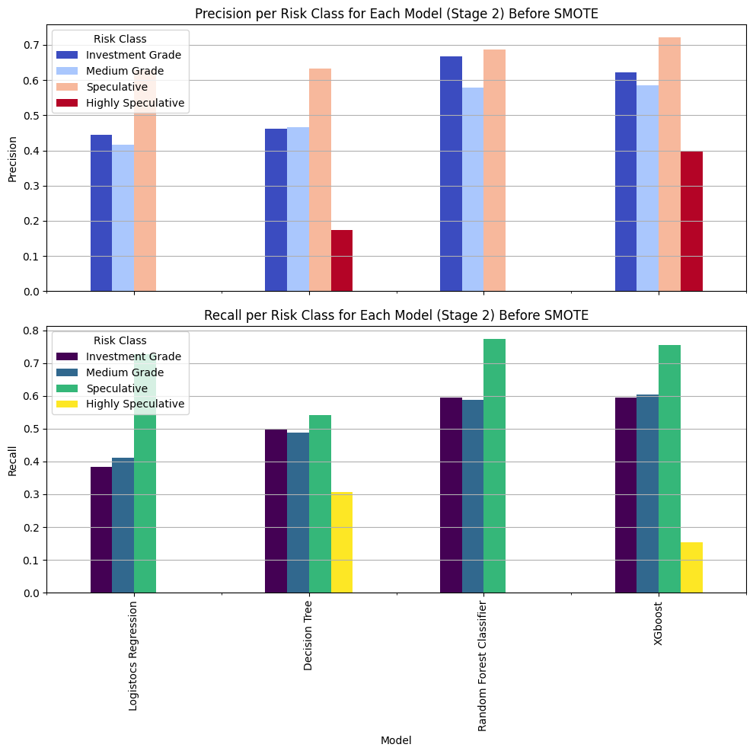
Model’s Performance – Stage 2 (Grouped Rating Prediction)
Before SMOTE

Slide 23
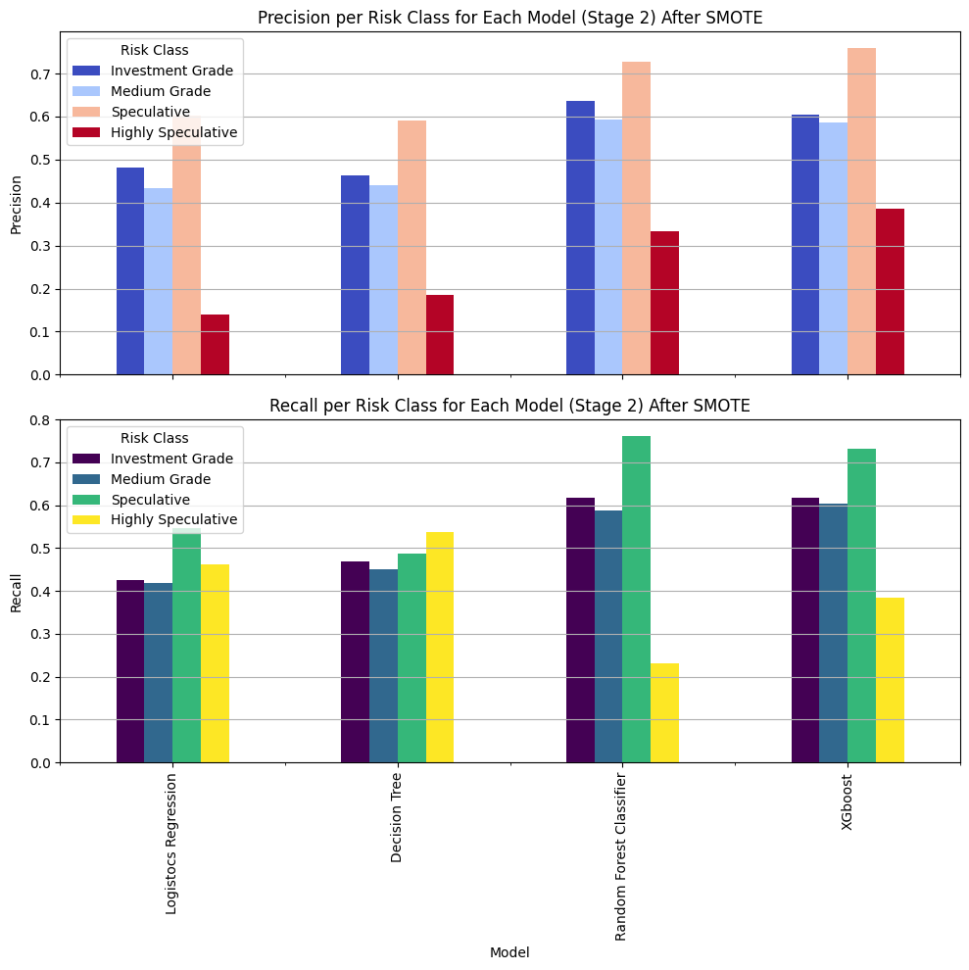
Performance After SMOTE

Slide 24
Model Optimization – Hyperparameter Tuning
Why Optimize?
Complex models like Random Forest and XGBoost underperformed in Stage 2 (low recall for rare class)
Default parameters were not ideal for imbalanced, multi-class classification.
Tuning Method:
Applied GridSearchCV with 5-fold cross-validation.
Random Forest Best Params:
{ 'n_estimators': 200, 'max_depth': 20,'min_samples_split': 2,'min_samples_leaf': 1,'class_weight': 'balanced'}
XGBoost Best Params:
{'colsample_bytree': 1.0, 'learning_rate': 0.1, 'max_depth': 7, 'n_estimators': 200, 'subsample': 0.8}
Goal: Improve model’s sensitivity to minority class (Highly Speculative) Outcome: XGBoost showed best class-wise balance after tuning, especially improved recall for class 3

Slide 25
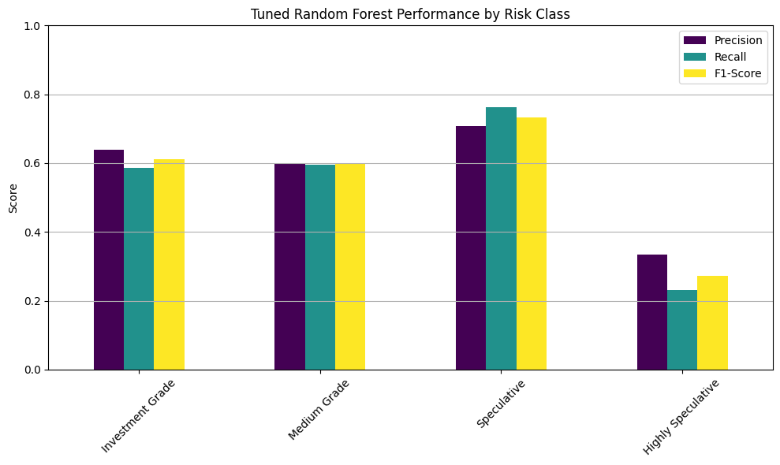
Random Forest Performance After Tuning

Slide 26
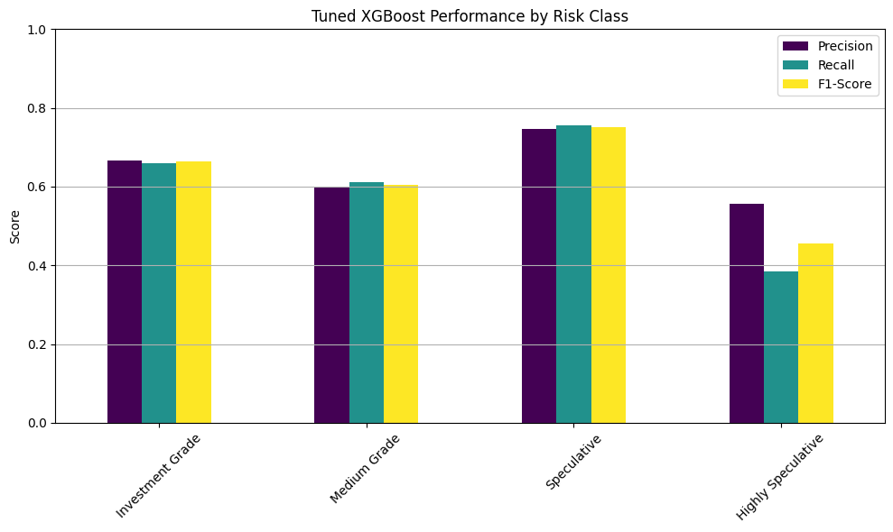
XGBoost Performance After Tuning

Slide 27
Minority Class (Highly Speculative) Performance Across Models
Model | Precision (Before SMOTE) | Recall (Before SMOTE) | Precision (After SMOTE) | Recall (After SMOTE) | Precision (After Tuning) | Recall (After Tuning)
Logistics Regression | 0.00 | 0.00 | 0.14 | 0.46 | - | -
Decision Tree | 0.17 | 0.34 | 0.18 | 0.54 | - | -
Random Forest | 0.00 | 0.00 | 0.33 | 0.23 | 0.33 | 0.23
XGBoost | 0.40 | 0.15 | 0.38 | 0.38 | 0.56 | 0.38
This table highlights how each model improved in identifying rare high-risk companies through SMOTE and tuning.
XGBoost after tuning delivered the best balance between precision and recall, making it the most effective model for sensitive credit risk detection.

Slide 28
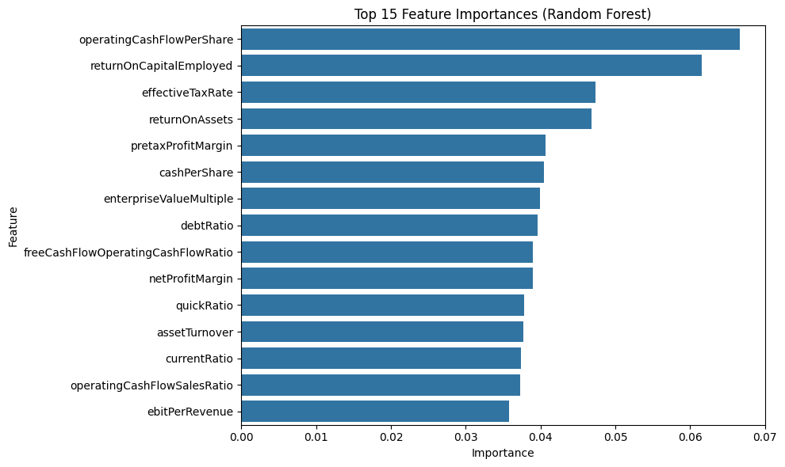
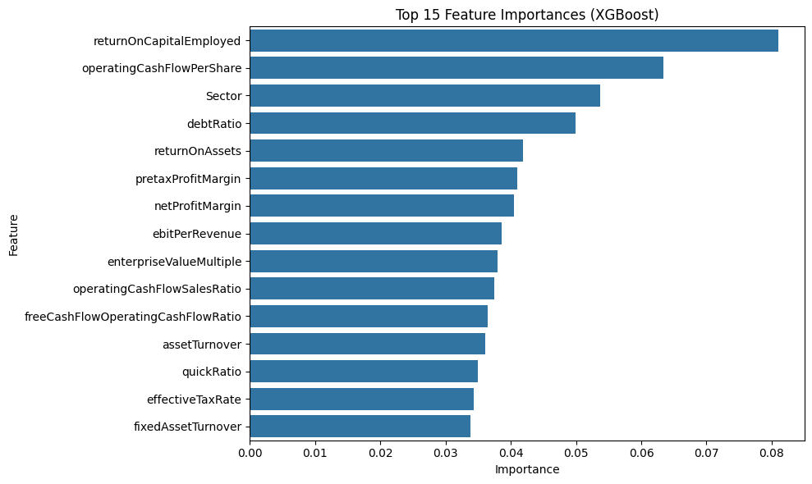
Feature Importance

Slide 29
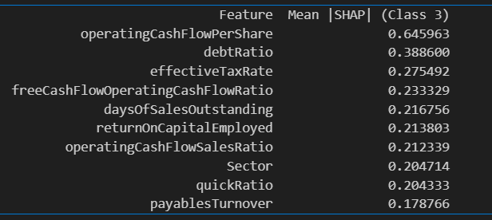
SHAP ANALYSIS
SHAP Analysis – Explaining Model Decisions for High-Risk Firms
Focused SHAP analysis on Class 3 (Highly Speculative) to understand what drives high-risk classification for XGBoost Models.
Key Drivers:
->Low operating cash flows
->high debt ratio
->weak tax efficiency

Slide 30
Conclusion: Key Takeaways
Objective: Predict credit ratings and classify companies into risk categories.
Feature Engineering: Handled missing values, applied encoding to categorical variables, and scaled the features for better model performance.
Class Imbalance: Addressed via relabeling ratings into broader risk groups and used SMOTE for balancing the data, improving performance on rare classes like Highly Speculative.
Modeling: Optimized models (XGBoost and Random Forest) with hyperparameter tuning for better class balance and recall.
Feature Importance: Top features such as operating cash flow per share, return on capital employed, and effective tax rate played a major role in predictions.
Next Step
Enhance Data Diversity: Collect more diverse data across industries or generate synthetic data to improve model robustness, particularly for rare classes.

Slide 31
Q&A

Slide 32
Why Not Use 5-Level Risk Grouping? (Rejected Option)
Alternative Grouping Idea (Not Used)
Issue: “Lowest Risk” class has only 7 samples — too imbalanced for training or resampling.
Rating | Grouped Label
AAA | Lowest Risk
AA,A | Low Risk
BBB | Medium Risk
BBB,B | High Risk
CCC,CC,C | Highest Risk
Risk level | Count
AAA | 7
AA,A | 487
BBB | 671
BB,B | 792
CCC,CC,C | 71

